Slide 1

Security+
Exam SY0-601
Chapter 27
Incident Response Policies, Processes, and Procedures
Notes:
Gain Attention

Slide 2
Chapter 27 (Domain 4.2) Learning Objectives
Summarize the importance of policies, processes, and procedures for incident response.
Incident response plans
Incident response process
Preparation
Identification
Containment
Eradication
Recovery
Lessons learned
Exercises
Tabletop
Walkthroughs
Simulations
Attack frameworks
MITRE ATT&CK
The Diamond Model of Intrusion Analysis
Cyber Kill Chain
Stakeholder management
Communication plan
Disaster recovery plan
Business continuity plan
Continuity of operations planning (COOP)
Incident response team
Retention policies

Slide 3
Incident Response Plan
An Incident Response Plan (IRP) describes the steps an organization performs in response to any situation determined to be abnormal in the operation of a computer system or network.
There are many causes of “incidents”.
Low impact
Moderate impact
High impact
To manage incidents when they occur, an IT team needs to create an incident response plan that includes a table of guidelines to assist in determining the level of response.

Slide 4
Incident Response Plan
Two major elements play a role in determining the level of response.
Information criticality is the primary determinant, and this comes from the data classification and the quantity of data involved.
How the incident potentially affects the organization’s operations.
A series of breaches, whether minor or not, indicates a pattern that can have public relations and regulatory issues.
The incident response plan will cover a wide range of items.

Slide 5
Incident Response Process
The incident response process is the set of actions security personnel perform in response to a wide range of triggering events.
These actions are broad and varied, as they have to deal with numerous causes and consequences.
Incident response activities at times are closely related to other IT activities involving IT operations.
Incident response activities can be similar to disaster recovery and business continuity operations.

Slide 6
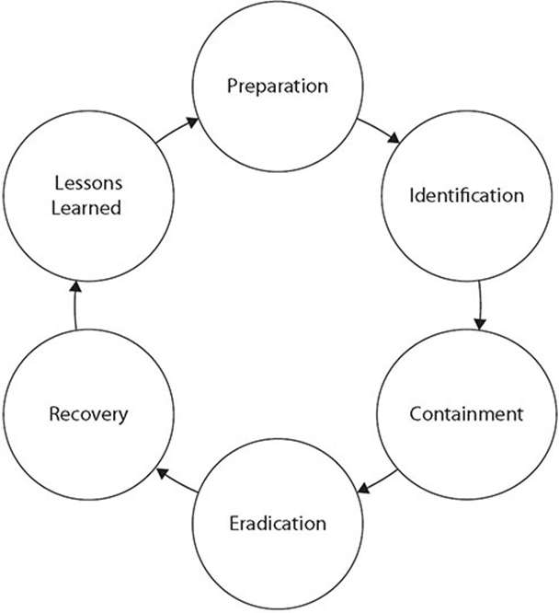
Incident Response Process
Six phases of the incident response process:

Slide 7
Incident Response Process
Preparation is the phase of incident response that occurs before a specific incident.
Preparation includes all the tasks needed to be organized and ready to respond to an incident.
Through the use of a structured framework coupled with properly prepared processes, incident response becomes a manageable task.
Without proper preparation, this task can quickly become impossible or intractably expensive. Successful handling of an incident is a direct result of proper preparation.

Slide 8
Incident Response Process
Identification is the process where a team member suspects that a problem is bigger than an isolated incident and notifies the incident response team for further investigation.
An incident is defined as a situation that departs from normal, routine operations.
Whether an incident is important or not is the first point of decision as part of an incident response process.
One unsuccessful login vs 10,000 unsuccessful logins.
A key first step is to process the information and determine whether or not to invoke incident response processes.

Slide 9
Incident Response Process
Containment is the set of actions taken to constrain the incident to a minimal number of machines
Contain the incident and prevent its spread.
This preserves as much of production as possible and ultimately makes handling the incident easier.
This can be complex because, in many cases, containing the problem requires fully understanding it as well as its root cause and the vulnerabilities involved.

Slide 10
Incident Response Process
Eradication involves removing the problem, and in today’s complex system environment, this may mean rebuilding a clean machine.
A key part of operational eradication is the prevention of reinfection.
One of the strongest value propositions for virtual machines is the ability to rebuild quickly, making the eradication step relatively easy.

Slide 11
Incident Response Process
Recovery is the process of returning the asset into the business function and restoring normal business operations.
The recovery process includes the steps necessary to return the system and applications to operational status.
This could involve reimage the asset or replace the asset.

Slide 12
Incident Response Process
Lessons learned phase serves two distinct purposes.
The first is to document what went wrong and allowed the incident to occur in the first place.
Failure to correct this means a sure repeat.
The second is to examine the incident response process itself.
Questions to answer:
Where did it go well?
Where did problems occur?
How can it be improved?
Continuous improvement of the actual incident response process is an important task.

Slide 13
Exercises
Exercises come in many forms and functions and doing a tabletop exercise where the planning and preparation steps are tested is an important final step in the planning process.
Having a process and a team assembled is not enough unless the team has practiced the process on the systems of the enterprise.

Slide 14
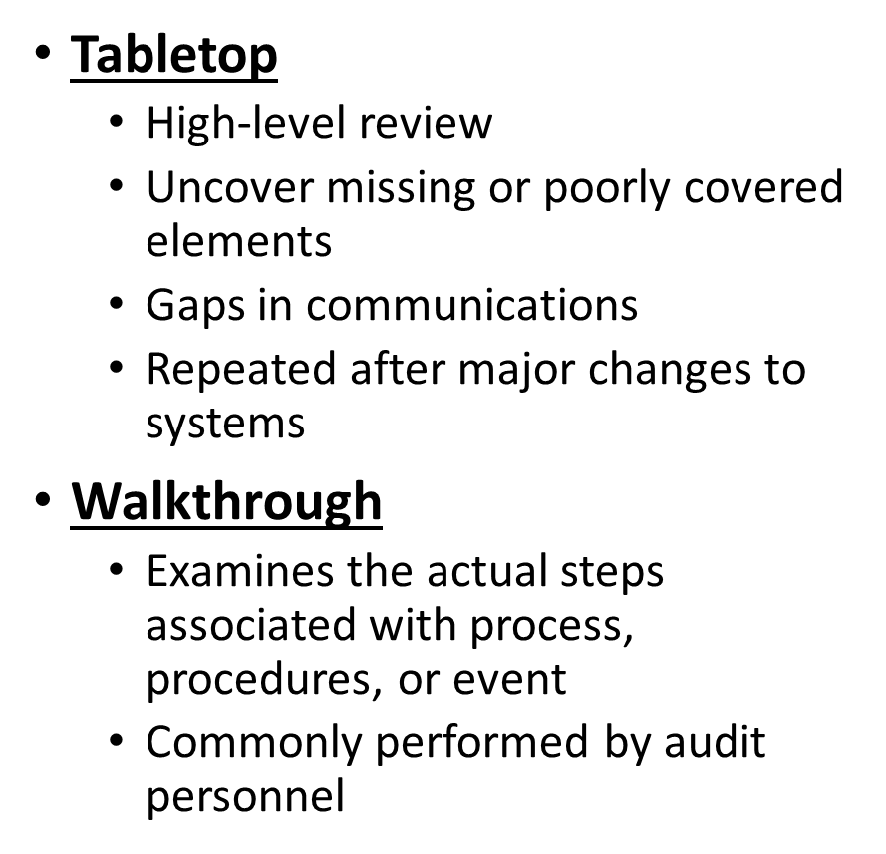
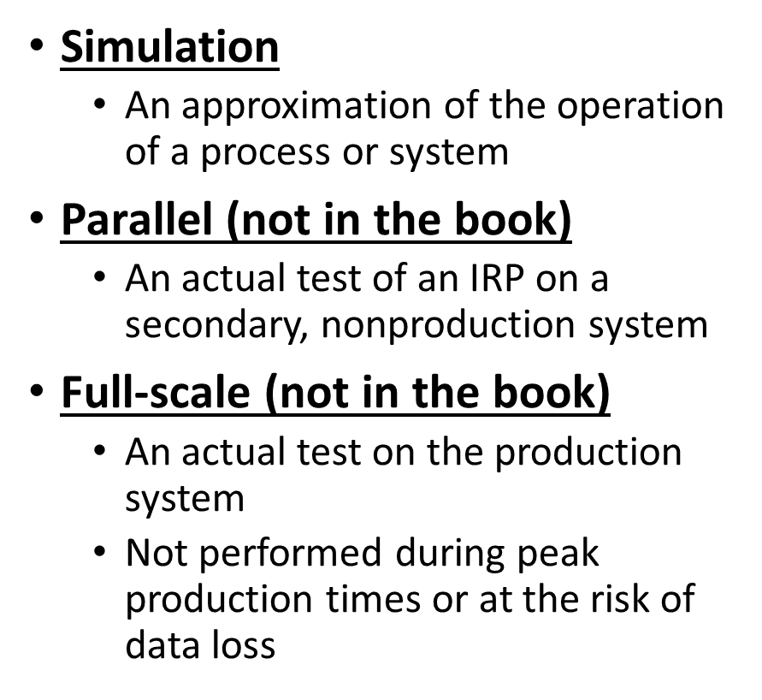
Types of Exercises

Slide 15
Attack Frameworks
Attack frameworks provide a roadmap of the types of actions and sequence of actions used when attacking a system.
Frameworks bring a sense of structure and order to the multidimensional problem associated with defending a variety of systems against multiple different types of attackers with various objectives.
The objective of using a framework is to improve post-compromise detection of adversaries in enterprises by providing guidance on where an adversary’s actions may be observable and where one can take specific actions.
Organizations can use frameworks to identify holes in defenses and prioritize them based on the risk associated with actions an adversary is likely to take.
Three different frameworks: the MITRE ATT&CK framework, the Diamond Model of Intrusion Analysis, and the Cyber Kill Chain.

Slide 16
MITRE ATT&CK
The MITRE ATT&CK framework is a comprehensive matrix of attack elements, including the tactics and techniques used by attackers on a system.
This framework can be used by threat hunters, red teamers, and defenders to better classify attacks and understand the sequential steps an adversary will be taking when attacking a system.
This framework enables personnel to plan and defend, even during an attack, and further it acts as a useful tool in assessing an organization’s risk.
Simple design:
Initial access, execution, persistence, privilege escalation, defense evasion, credential access, discovery, lateral movement, collection, command and control, exfiltration, and impact.

Slide 17
The Diamond Model of Intrusion Analysis
The Diamond Model of Intrusion Analysis is a cognitive model used by the threat intelligence community to describe a specific event.
It is based on the notion that an event has four characteristics, each comprising a corner of the diamond.
The four nodes that make up an event are adversary, infrastructure, capability, and victim.

Slide 18
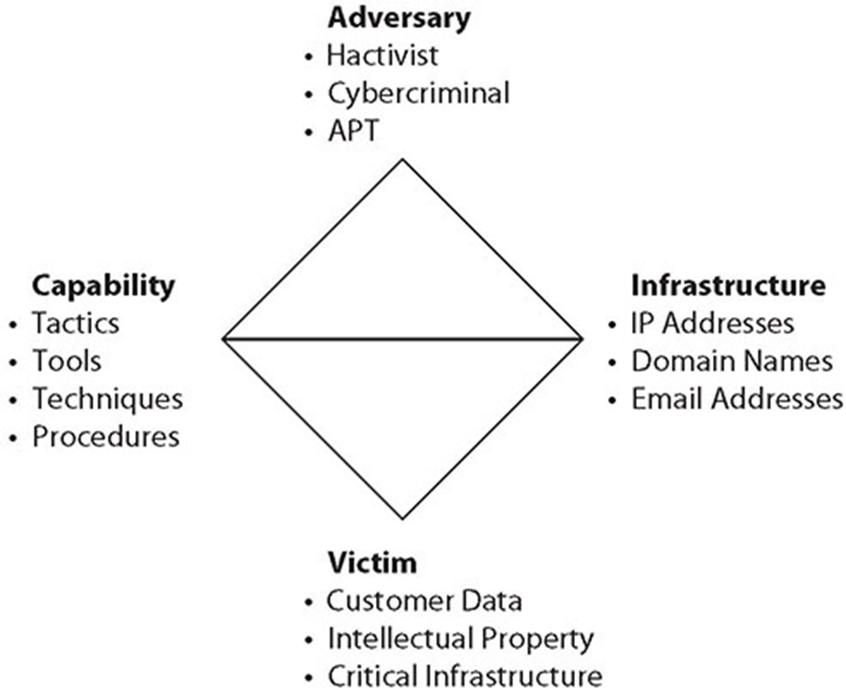
The Diamond Model of Intrusion Analysis

Slide 19
Cyber Kill Chain
The Cyber Kill Chain is a model developed by Lockheed Martin as a military form of engagement framework.
This model has a series of distinct steps that an attacker uses during a cyberattack.
The use of the Cyber Kill Chain helps us understand and combat different forms of attack—from ransomware, to security breaches, and even Advanced Persistent Threats (APTs).

Slide 20
Cyber Kill Chain
Steps in the Cyber Kill Chain:
1. Reconnaissance Research and identify targets.
2. Weaponization Exploit vulnerabilities to enter.
3. Delivery Deliver the payload (evil content).
4. Exploitation Begin the payload attack on the system and gain entry.
5. Installation Implement backdoors, persistent access, bots, and so on.
6. Command and Control Communicate to outside servers for control purposes.
7. Action on Objective Obtain the objective of the attack (for example, steal intellectual property).

Slide 21
Stakeholder Management
Stakeholders are the parties that have an interest in a process or the outcome of a process.
Stakeholders can be internal or external to an organization.
Internal stakeholders:
Corporate legal, communications, liaisons with regulators, customer support elements, and the operations personnel
External stakeholders:
Vendors, customers, regulators, auditors, other outside groups
Having a stakeholder management process, including defined personnel roles and responsibilities, is essential for the management of the stakeholders and their relationships during incidents.

Slide 22
Communication Plan
A communication plan as part of the incident response effort that answers the preceding questions and defines responsibilities for communication is a key element to be developed during the preparation phase.
Reporting requirements can refer to industry, regulatory, and statutory requirements in addition to internal communications.
Understanding the reporting requirements to external entities is part of the responsibility of the communications lead on the team.
Having the correct information in the hands of the correct people at the correct time is an essential part of reporting, and a prime responsibility of the communications lead on the team.

Slide 23
Disaster Recovery Plan
A Disaster Recovery Plan (DRP) defines the data and resources necessary, and the steps required to restore critical organizational processes.
A Disaster Recovery Plan is critical for effective disaster recovery efforts.

Slide 24
Disaster Recovery Plan
To begin creating your DRP, first identify all critical functions for your organization and then answer the following questions for each of these critical functions:
Who is responsible for the operation of this function?
What do these individuals need to perform the function?
When should this function be accomplished relative to other functions?
Where will this function be performed?
How is this function performed (what is the process)?
Why is this function so important or critical to the organization?

Slide 25
Disaster Recovery Plan
The name often used to describe the document created by addressing these questions is business impact assessment (BIA).
Both the disaster recovery plan and the business impact assessment, will need to be approved by management, and it is essential that they buy into the plan—otherwise your efforts will more than likely fail.
A good DRP must include the processes and procedures needed in order for your organization to functioning properly and to ensure continued operation.
These processes should be documented and, where possible and feasible, reviewed and exercised on a periodic basis.

Slide 26
Business Continuity Plan
The Business Continuity Plan (BCP) represents the planning and advanced policy decisions to ensure the business continuity objectives are achieved during a time of obvious turmoil.
The focus of a BCP is the continued operation of the essential elements of the business or organization.
Business continuity is not about normal operations, but rather about trimmed-down, essential operations only.
The BCP will describe the functions that are most critical, based on a previously conducted business impact analysis, and will describe the order in which functions should be returned to operation.

Slide 27
Continuity of Operation Planning (COOP)
The overall goal of Continuity of Operation Planning (COOP) is to determine which subset of normal operations needs to be continued during periods of disruption.
Continuity of Operation Planning involves developing a comprehensive plan to enact during a situation where normal operations are interrupted.
This includes identifying critical assets (including key personnel), critical systems, and interdependencies as well as ensuring their availability during a disruption.
Developing a continuity of operations plan is a joint effort between the business and the IT team.
Senior management will have to make the major decisions concerning balancing risk versus cost versus criticality when examining hot, warm, or cold site strategies.

Slide 28
Incident Response Team
The Cyber Incident Response Team (CIRT) is composed of the personnel who are designated to respond to an incident.
Whether a dedicated team or a group of situational volunteers, the planning aspect of incident response needs to address the topic of who is on the team and what their duties are.
Management needs to appoint the team members and ensure that they have time to be prepared for service.
The team is responsible for all phases of the incident response process.
A critical step in the incident response planning process is to define the roles and responsibilities of the incident response team members.

Slide 29
Retention Policies
Data retention is the storage of data records.
One of the first steps in understanding data retention in an organization is the determination of what records require storage and for how long.
Many reasons for retaining data:
billing and accounting
contractual obligation
warranty history
compliance with local, state, and national government regulations, such as IRS rules

Slide 30
Retention Policies
Maintaining data stores for longer than is required is a source of risk, as is not storing the information long enough.
Some information is subject to regulations requiring lengthy data retention, such as PHI for workers who have been exposed to specific hazards.
Some data elements, such as the card verification code (CVC/CV2) element in a credit card transaction, are never stored as part of a transaction record.
They are used for approval and destroyed to prevent loss after the transaction is concluded.

Slide 31
Retention Policies
Failure to maintain the data in a secure state can also be a retention issue, as is not retaining it.
In some cases, destruction of data, specifically data subject to legal hold in a legal matter, can result in adverse court findings and sanctions.
Even if the data destruction is unintentional or inadvertent, it is still subject to sanction, as the firm had a responsibility to protect it.
Legal hold:
Once data is on the legal hold track, its retention clock does not expire until the hold is lifted.
This makes identifying, labeling, and maintaining the data subject to a legal hold an added dimension to normal storage considerations.

